Slide 1

Artificial Intelligence: Unlocking the Future of Productivity
Kevin Grossnicklaus, President
kvgros@architectnow.net
Alex Will, CTO
awill@architectnow.net
www.architectnow.net

Slide 2
Artificial Intelligence (AI) Overview
Brief History
Large Language Models (LLMs)
Generative AI
Text/Images/Audio/Video
ChatGPT
Prompts

Slide 3
Public AI vs Private AI
What is shared?
Baseline (i.e. shared or common) knowledge
vs.
Company and/or User specific knowledge/training

Slide 4
Public AI Demos
ChatGPT / DALL-E
https://chat.openai.com/
Microsoft Edge
https://www.microsoft.com/en-us/edge/features/copilot
Google Gemini
https://gemini.google.com/app

Slide 5






Microsoft 365 Copilot
Unleash creativity
Unlock productivity
Uplevel skills
Harness the power of AI so you never have to start from scratch
Let AI summarize actions for you, and optimize your time
Be better at what you’re good at and master what you’ve yet to learn

Slide 6
Microsoft 365 Copilot
Available Now
Integrated into the Microsoft 365 Platform
Access from:
Desktop (Mac/Windows), Web, Tablet/Mobile

Slide 7
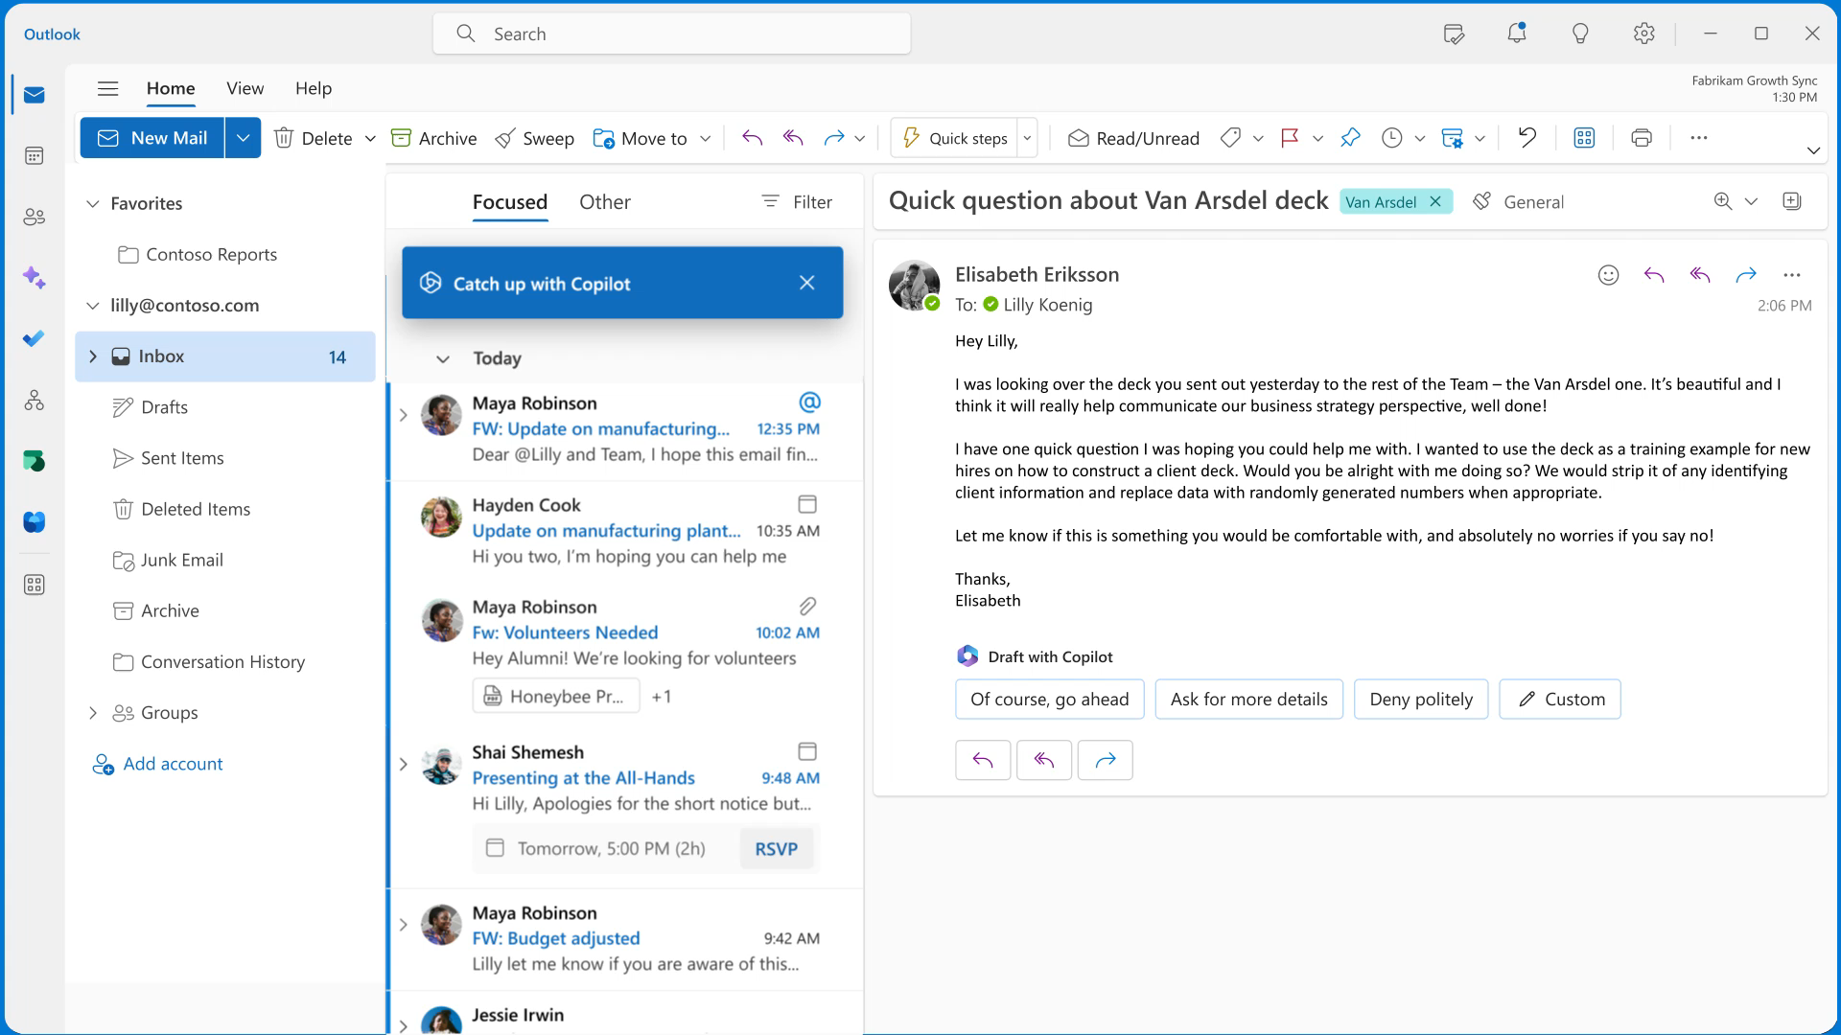
Review email inbox to find customer inquiries and supplier updates
Copilot in Outlook
Copilot works alongside to manage the daily inbox.
Business needs:
Facilitate review of recent emails
Flag important items; specifically, customer feedback and supplier
concerns
Draft customized responses to each inquiry. Further trim text and apply a professional tone.

Slide 8

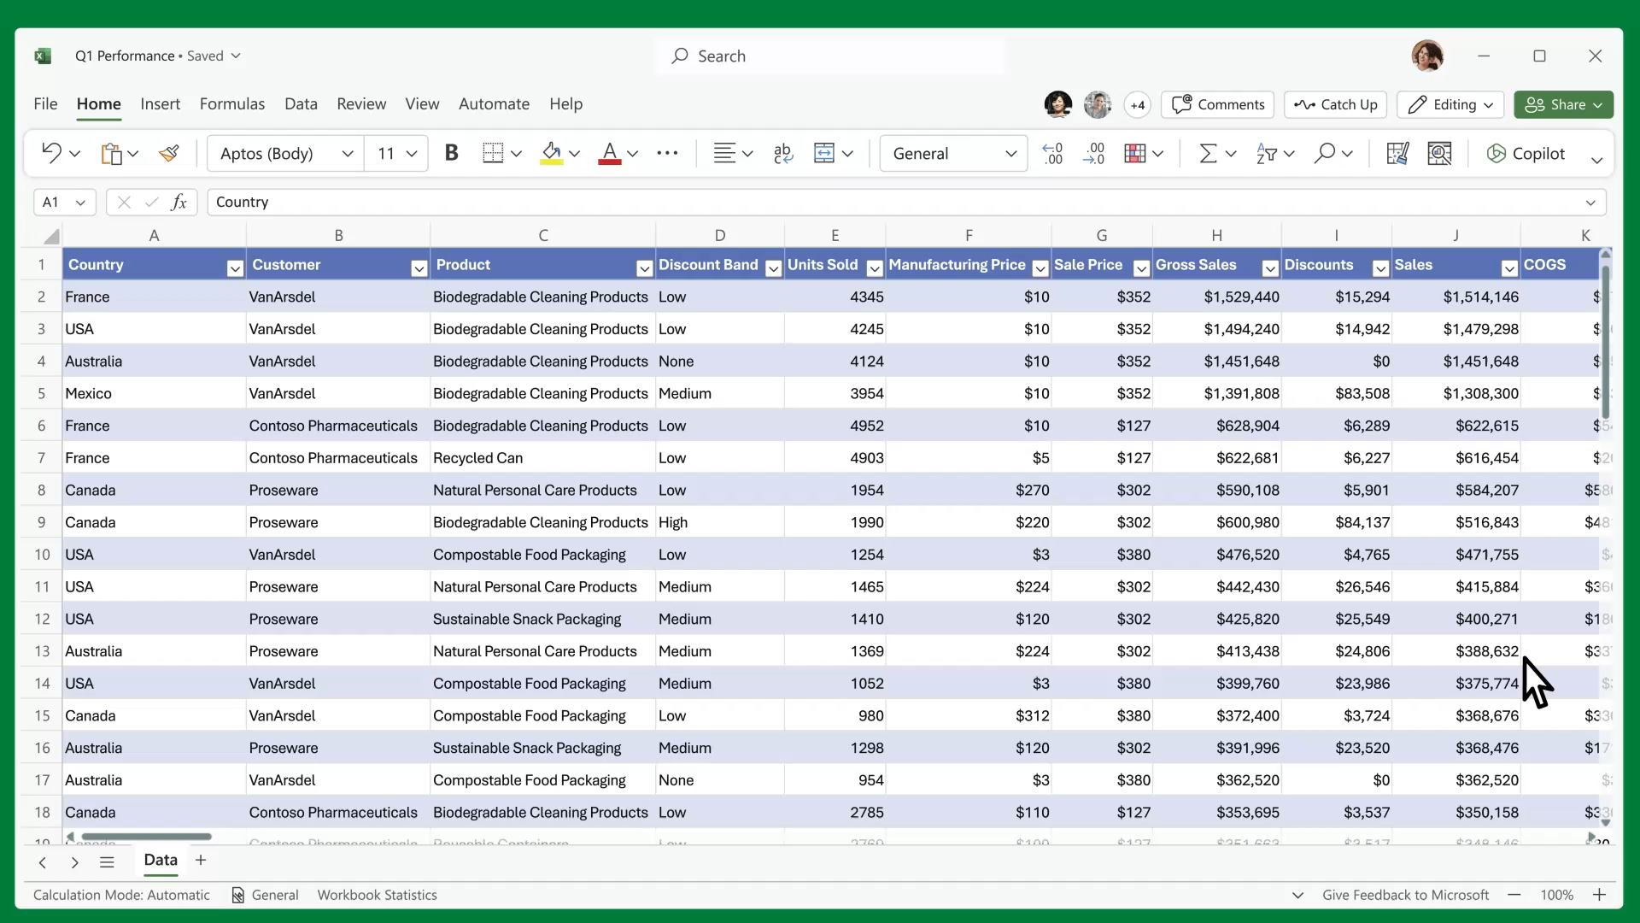
Provide comparison on online vs in-person sales
Copilot in Excel
Copilot works alongside to analyze trends and create professional-looking data.
Business needs:
Break down sales by type and channel
Project the impact of increasing online inventory
Reformat data into a visual chart to model how inventory shifts could impact the gross margin
Create visual charts to share with the team

Slide 9
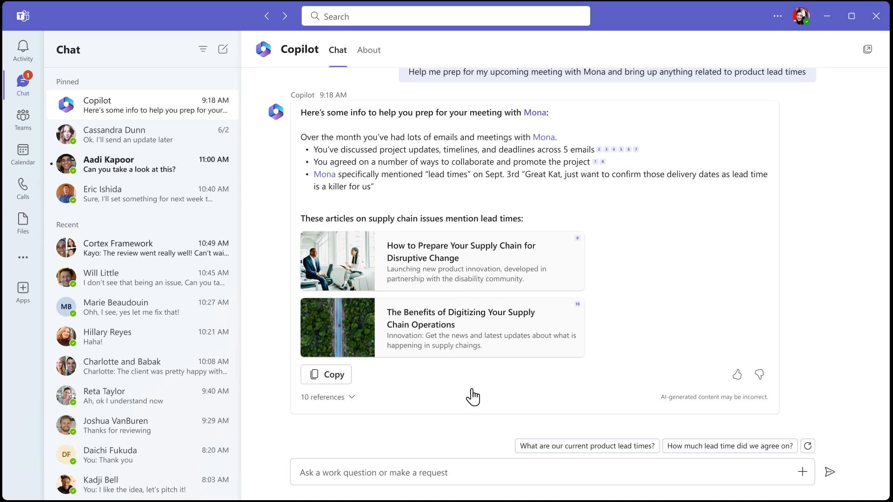
Summarize feedback from customers on the buying experience
Microsoft 365 Chat
Copilot works alongside to summarize data across documents, presentations, email, calendar, notes, & contacts.
Business needs:
Bring together data—summarizing the chats, email, and documents related to customer feedback
Determine the pros and cons of moving more inventory to online
Write a planning overview, using last quarter’s sales and a summary of customer comments

Slide 10
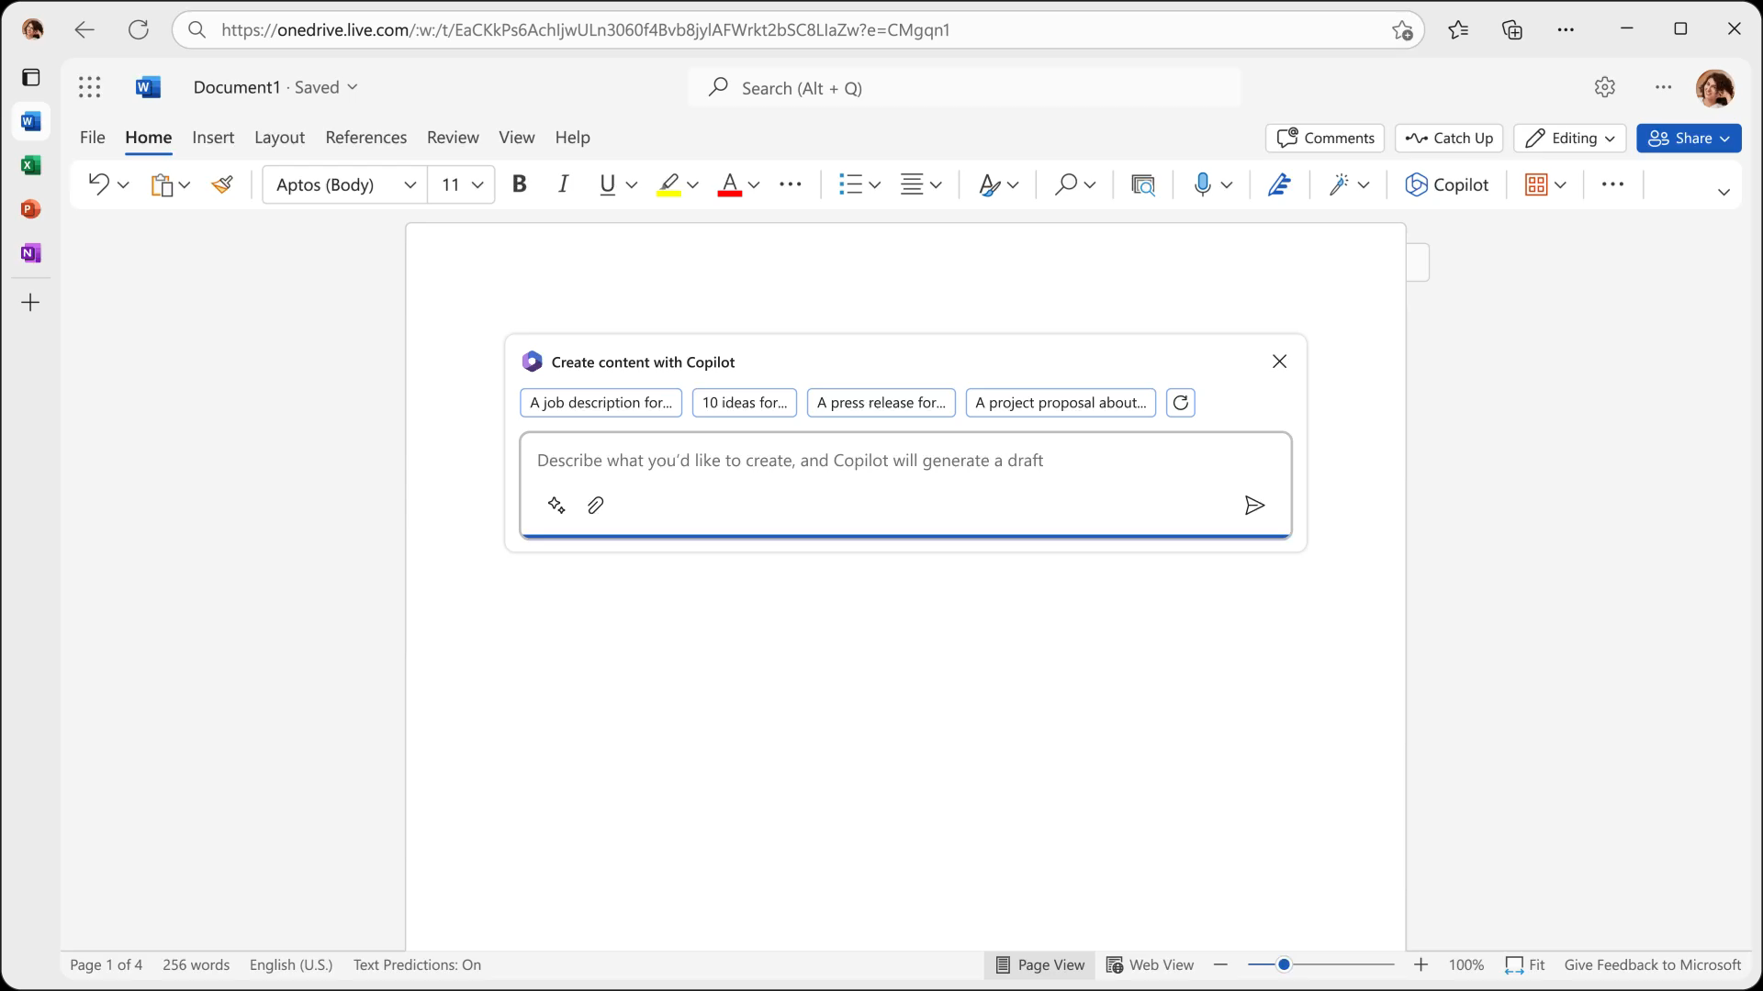
Create a proposal to update the store’s website
Copilot in Word
Copilot helps write, edit, summarize, & create.
Business needs:
Draft a two-page project proposal based on the data from customer feedback
and sales
Make the third paragraph more concise. Change the tone of the document to be more casual
Create a one-page draft based on this rough outline

Slide 11

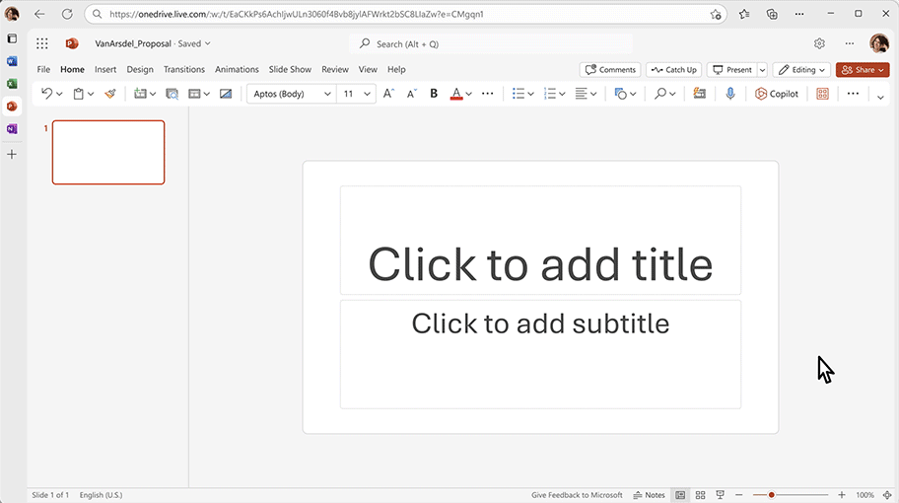
Create a presentation on sustainability goals
Copilot in PowerPoint
Copilot helps to create visually stunning presentations.
Business needs:
Create a five-slide presentation based on a Word document, include relevant stock photos
Consolidate that presentation into a three-slide summary
Reformat three bullets into three columns, each with a photo

Slide 12
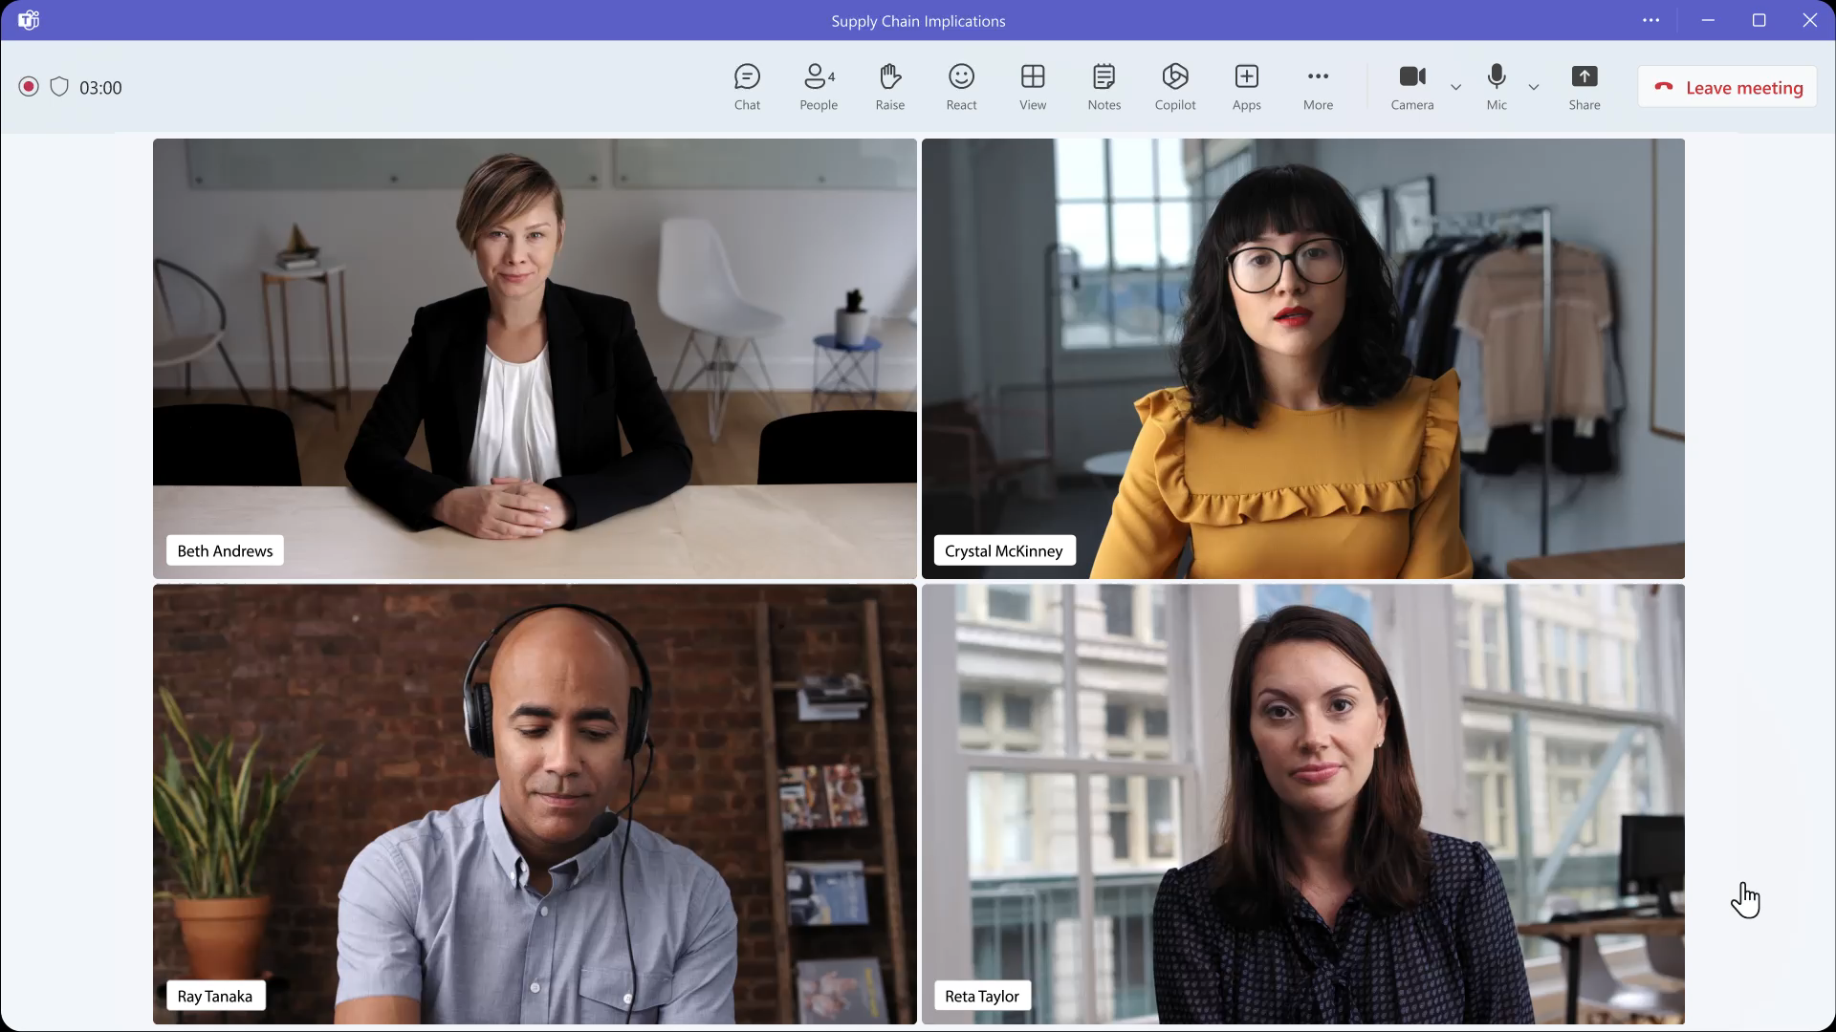
Recap an internal meeting on sustainability requirement impact on inventory
Copilot in Teams
Copilot helps you run more effective meetings.
Business needs:
Summarize the meeting—including decisions made and suggested next steps
Create a table illustrating contingency steps

Slide 13

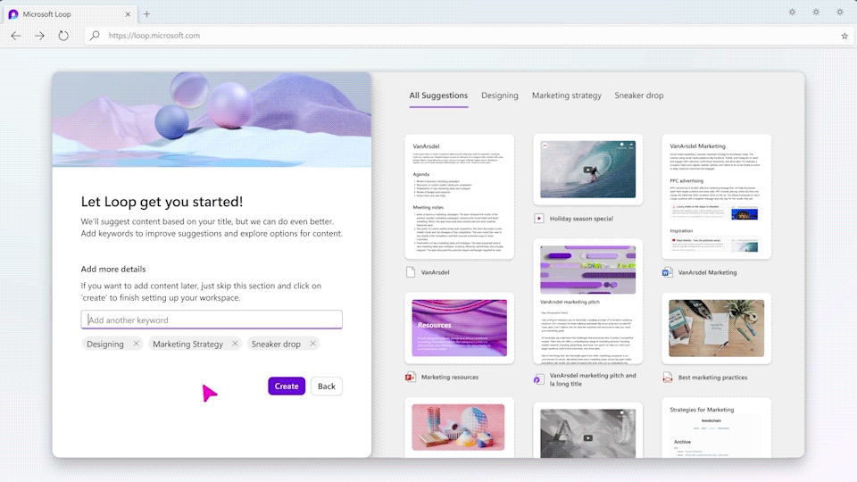
Create a shared space for collaboration that brings together people, content, and tasks across tools and devices
Microsoft Loop
Microsoft Loop helps organize everything needed for a project into a single workspace.
Business needs:
Find relevant content and organize into pages for easy viewing.
Turn parts of workspace into Loop components—portable pieces of content that stay in sync across Teams, Outlook and more.
Collaborate and track progress with notifications, highlighted changes, status labels, and task lists.

Slide 14

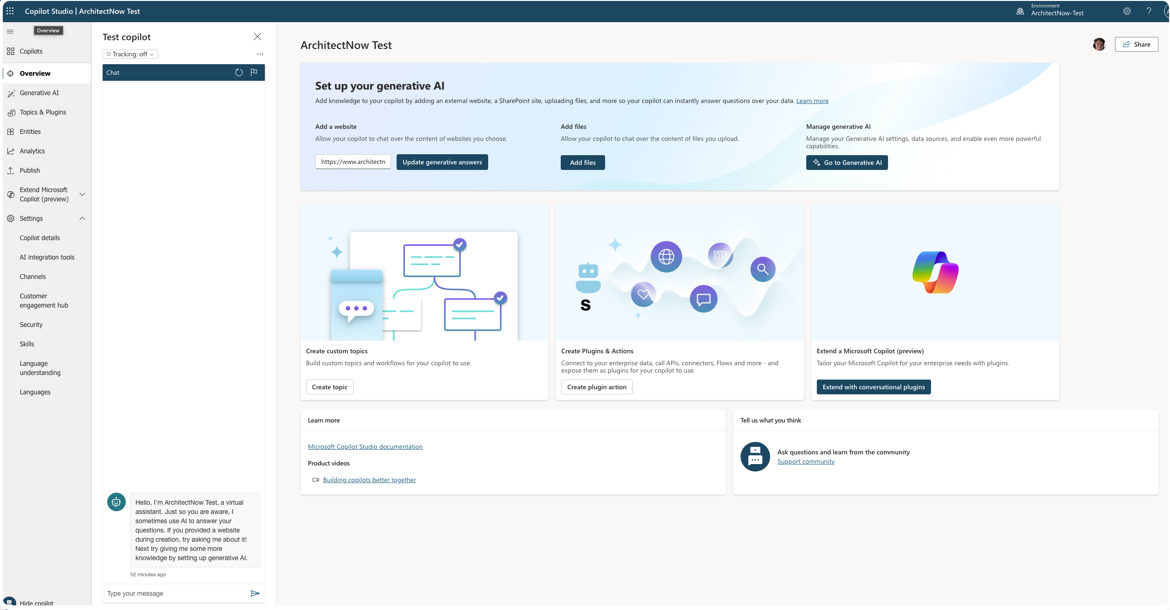
Powerful Connected Copilots – built by you
Copilot Studio
Copilot Studio allows you to customize and extend the Copilots and Bots in your organization
Business needs:
Enable greater control and efficiency by authoring responses to predictable scenarios within Copilot for Microsoft 365.
Incorporate your data and plugins for engaging interactions in the places that matter the most.
Copilot Studio is built on the foundations of leading conversational AI technologies including Power Virtual Agents and is interoperable with Azure AI Studio and more.
Graphic goes here

Slide 15
Powerful Connected Copilots – built by you
Copilot Studio
Copilot Studio allows you to customize and extend the Copilots and Bots in your organization
Business needs:
Enable greater control and efficiency by authoring responses to predictable scenarios within Copilot for Microsoft 365.
Incorporate your data and plugins for engaging interactions in the places that matter the most.
Copilot Studio is built on the foundations of leading conversational AI technologies including Power Virtual Agents and is interoperable with Azure AI Studio and more.
Integrate your local data
Train AI/Copilot to be more useful to your team
Provide access to real-time data within your organization
Customize responses and workflows

Slide 16
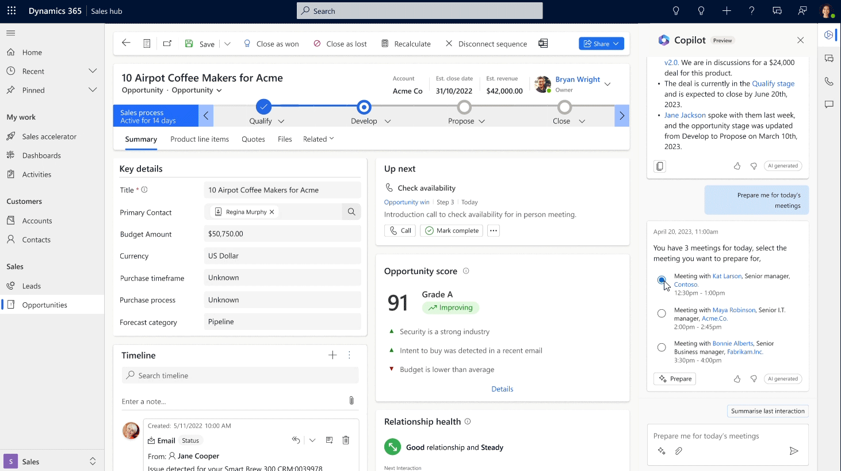
Transform the way sellers work
Microsoft Copilot for Sales
Drive efficiency with AI capabilities that help streamline processes and create personalized sales content in Microsoft 365 apps.
Business needs:
Work more efficiently using AI capabilities that help streamline processes and create personalized sales content.
Improve customer experiences with AI-generated insights and recommendations for next steps.
Seamlessly share information between Microsoft 365 apps and your CRM platform.
Graphic goes here

Slide 17

Get AI and Copilot Ready
Must use Microsoft 365 and store documents in the Cloud
Prerequisite Licensing Requirements
Requires at least one of the below per user
Microsoft 365 E5
Microsoft 365 E3
Office 365 E3
Office 365 E5
Microsoft 365 A5 for faculty
Microsoft 365 A3 for faculty
Office 365 A5 for faculty
Office 365 A3 for faculty
Microsoft 365 Business Standard
Microsoft 365 Business Premium
Cost for Copilot for Microsoft 365 Add-On
Retail Pricing: $360/year/user – paid upfront ($30/month)
ArchitectNow Pricing: $342/year/user – 5% Discount)

Slide 18
CoPilot Resources
Microsoft 365
Microsoft Copilot 365
Microsoft Copilot Studio
Microsoft Copilot for Sales
Microsoft Security Copilot

Slide 19
General AI Considerations
Quality/Accuracy
Security
Legality
Ethics
Evolution
Oversight

Slide 20
Closing Thoughts
AI will replace tasks not people
AI typically provides a ”starting point”
Everyone will use it
Everyone will learn to Prompt/Ask/Describe their needs to AI
AI will start to be “built-in” to most tools and software
Custom AI solutions will expand and provide more value to specific audiences
Searching the web (i.e. Google) will shift to asking AI questions

Slide 21
Where do we go from here?
Managed Services Provider
Microsoft License Management
Virtual Support
Security and Pricing Audits
Cloud Migrations
Business Applications
Kevin Grossnicklaus, ArchitectNow
kvgros@architectnow.net
Alex Will, CTO
awill@architectnow.net

Slide 22
Thank you.

